Slide 1
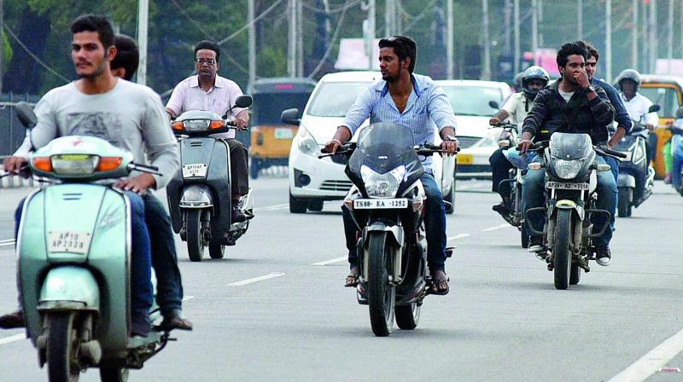
DETECTING TRAFFIC VIOLATION BY TWO WHEELER RIDERS
USING ML
MENTOR : Mr. VARUN GOEL
DIKSHANT MANOCHA
9915102071

Slide 2
OUTLINE
Problem Statement
Objective
Methodology
Technologies to be used
Future Aspects

Slide 3
PROBLEM STATEMENT
Two-wheelers involved in 95% road accidents.
There were a total of 2,113 cases of accidents reported in Trivandrum in 2017, out of which 2054 involved two-wheelers. As many as 55 persons lost lives in these accidents too.
377 people die every day, equivalent to a jumbo jet crashing every day.

Slide 4
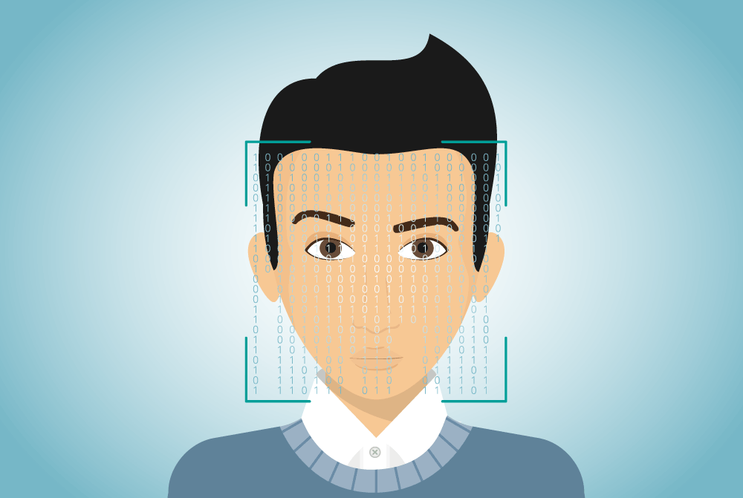
OBJECTIVE
Our aim is to penalize people riding their two wheelers without helmets using Machine Learning.

Slide 5
METHODOLOGY
Real time image capturing of road traffic and processing to check whether the rider and pillion rider are wearing helmet or not.
If either the rider or the pillion rider found not wearing the helmet then the real time decision making process starts.
After finding the riders not wearing the helmets their vehicle number plate will be processed.

Slide 6
METHODOLOGY (cntd..)
After extracting the vehicle registration number, a challan will be generated against respective vehicle and all the details of the challan will be sent via E-mail and SMS to the concerned person.
Now its upto the owner whether he/she wants to pay the fine via our mobile app or via our website or by visiting the nearest RTO.

Slide 7
TECHNOLOGIES TO BE USED
CCTV Camera
OpenCV Library
Optical Character Recognition (OCR)
Android studio for application designing
Java runtime environment of web
Tomcat web server
SQL Database

Slide 8

ABOUT TECHNOLOGIES
1. OpenCV
OpenCV was started at Intel in 1999
OpenCV is written in C++.
OpenCV supports a lot of algorithms related to Machine Learning and it is expanding day-by-day.
Currently OpenCV supports a wide
variety of programming languages
like C++, Python, Java etc and is
available on different platforms
including Windows, Linux, OS X,
Android, iOS etc

Slide 9

2. OCR
Optical Character Recognition is the mechanical or electronic conversion of images of typed, handwritten or printed text into machine-encoded text, whether from a scanned document, a photo of a document, a scene-photo.

Slide 10

3. Android Studio
It is the IntelliJ based IDE, for building android applications. Its environment supports languages xml, java.

Slide 11

4. Java
It’s an object oriented programming language.
Used for scripting android application,
Website & API’s.

Slide 12
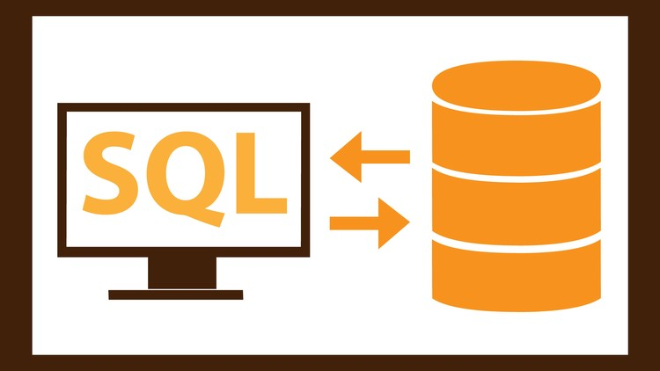
5. SQL Database
SQL (Structured Query Language)is a
query language used for managing data held
in a Relational database management
system (RDBMS).
Used for storing user & vehicle data.

Slide 13
Our Progress
Detecting 2-wheeler & rider
Detecting Rider with or without helmet
if(Ride is Without Helmet)
DetectNumberPlate();
else
continue;
endif;

Slide 14
Machine’s
Training

Slide 15


Slide 16
FUTURE ASPECTS
After successful completion of our demo project, we will make it possible for every state RTO to adopt this method.
Road accidents involving two-wheelers can be controlled to a great extent.
Even the traffic cops generating false challans for bribe can be caught by this method.
Giving Sikh’s as an exceptional case for this project.
Alert Today…. Alive Tomorrow

Slide 17
OBJECTIVE
Our aim is to penalize people riding their two wheelers without helmets using Machine Learning.

Slide 18
Progress Report
Previous
Current
Recognition of riders with and without helmet from front as well as from the side view.
Covering some special cases like riders wearing different caps or unsafe helmets.
After recognition of the helmet rule violator proceeding to check for the number plate with IND tag.
Passing the number plate to the OCR library for text extraction
Proper Recognition of two-wheeler riders.
Detecting whether the rider is wearing the helmet or not.
If the rider is not wearing the helmet then proceeding to detect the number plate.

Slide 19
Samples for
side view
&
Specials Cases

Slide 20
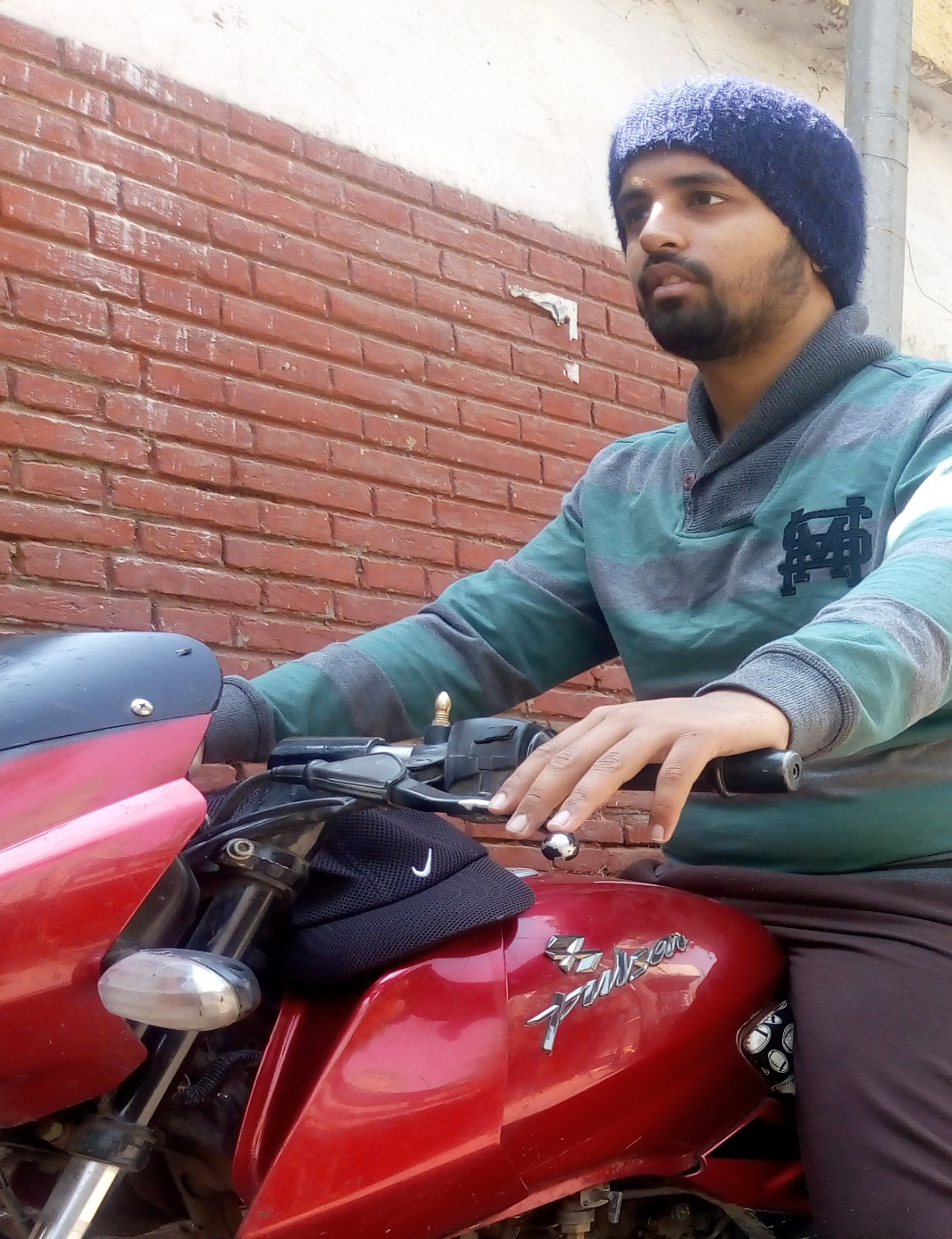

Slide 21
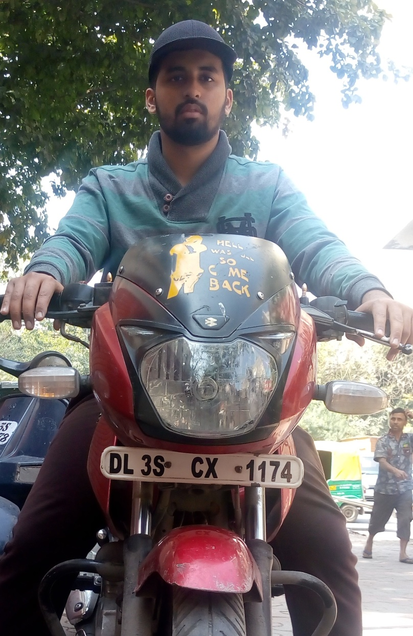

Slide 22
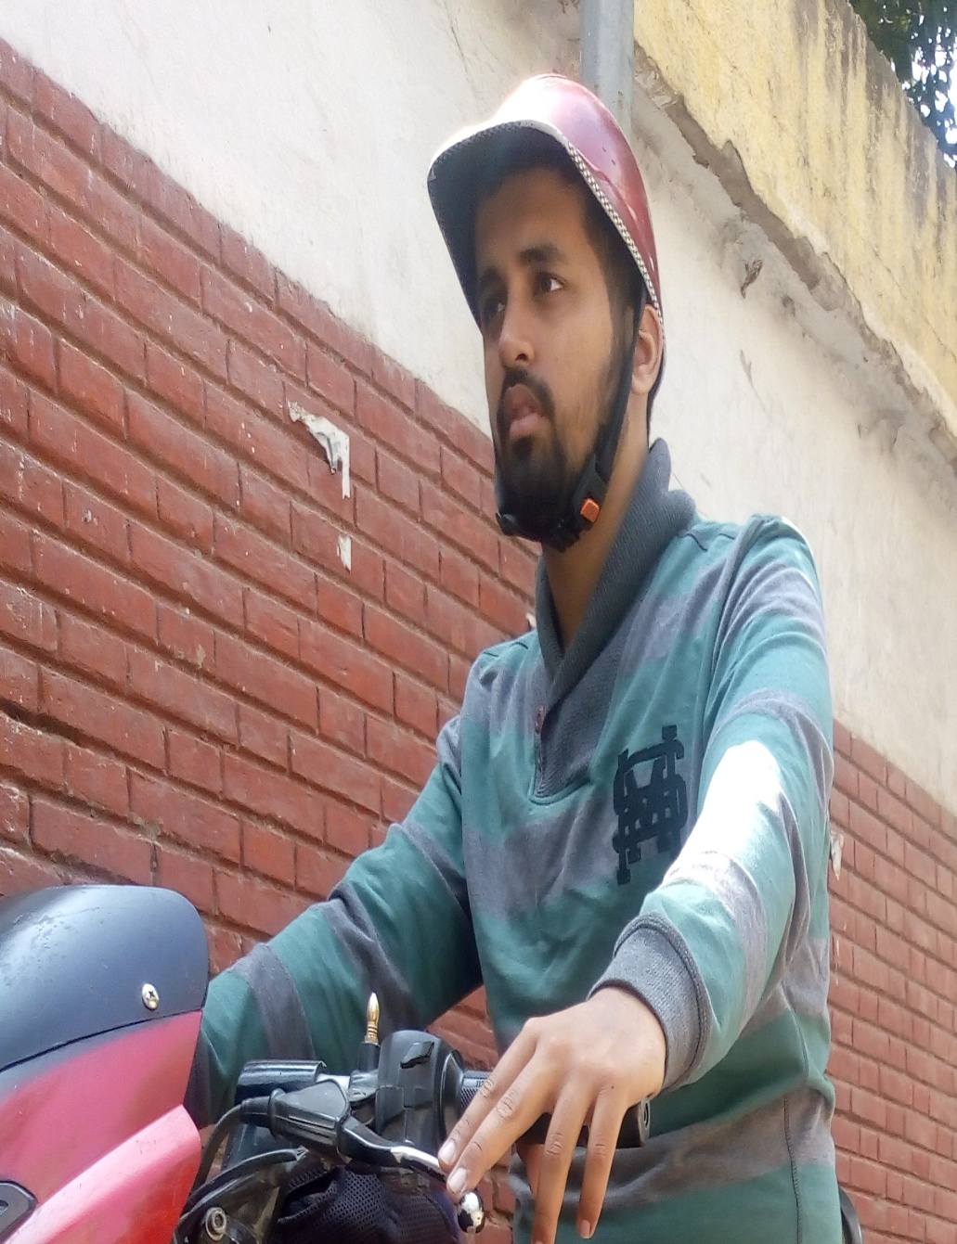

Slide 23
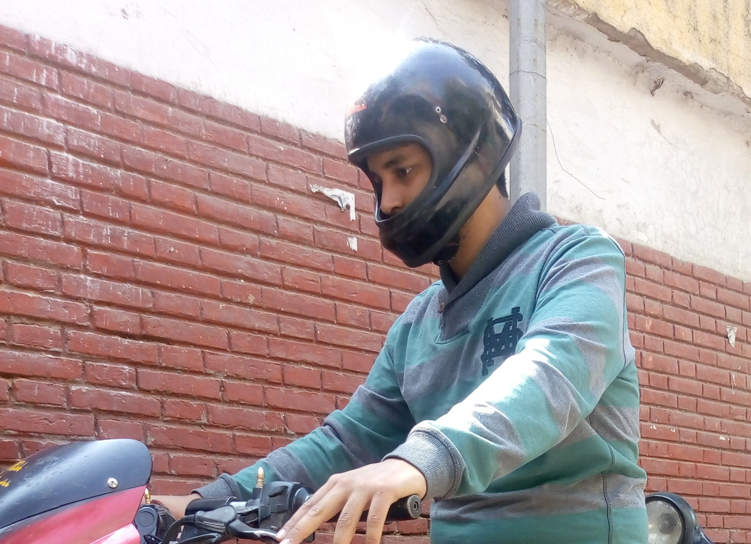

Slide 24
Text Extraction
Using
Optical Character Recognition
(OCR)

Slide 25
What’s Left
Working on the accuracy of number pate detection for multiple riders.
Working for improvements in text recognition.
Challan generation using the output of the text recognition and informing the owner for the challan generated via email. The email will contain an attachment of photograph of rider without helmet which will be the proof and reason for challan generation.
After challan generation payment of challan using direct link or from the designed software.
Software development for payment of challan generated using OTP login.
Final Report.

Slide 26
Thank You

